Slide 1

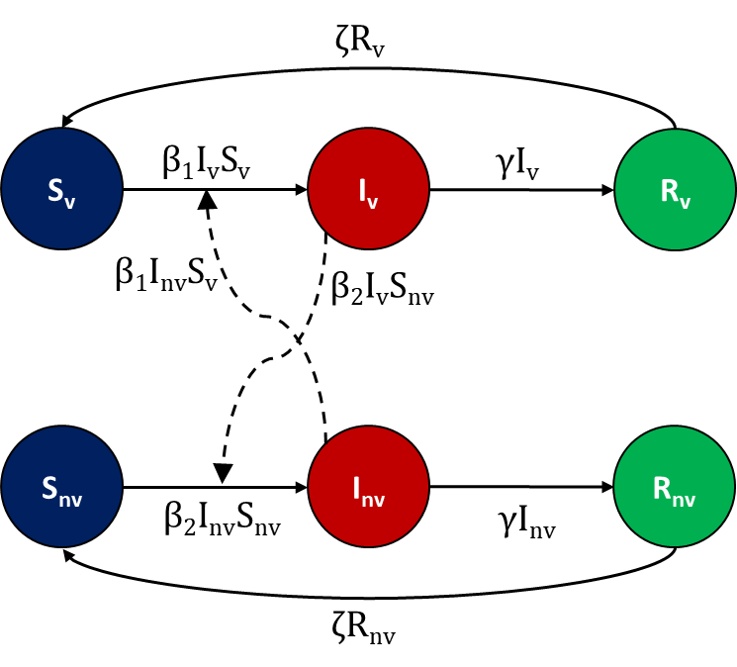
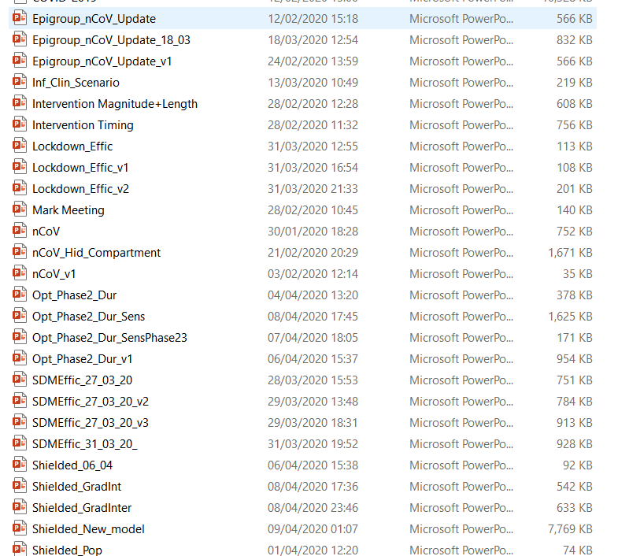



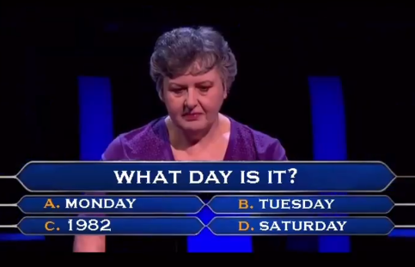

What I’ve Been Doing
Things I Still Need to Do
Modelling Social Distancing Measures of COVID-19
Timing
Magnitude
Exit strategies
Dashboard (previously)
Reading
I’ve been revisiting a lot of epidemiological and modelling theory!
Actual PhD Work
Finish up my Chapter 2 write up
Move onto next part of Chapter 3 model analysis
Formalise a write-up of the recent COVID-19 modelling work
Get better at balancing COVID-19, AMR modelling work and life

